Slide 1
Single page web application using react

Slide 2
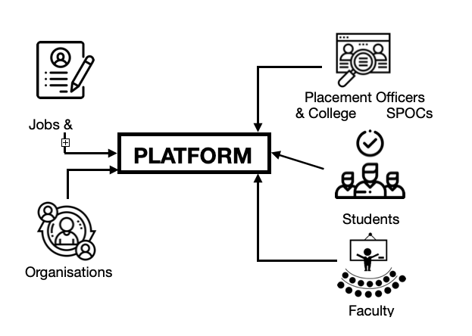
Problem statement
Design a platform which connects multiple organisational stakeholders to help students find matching jobs for their profile. The functionality of the platform is depicted below:

Slide 3
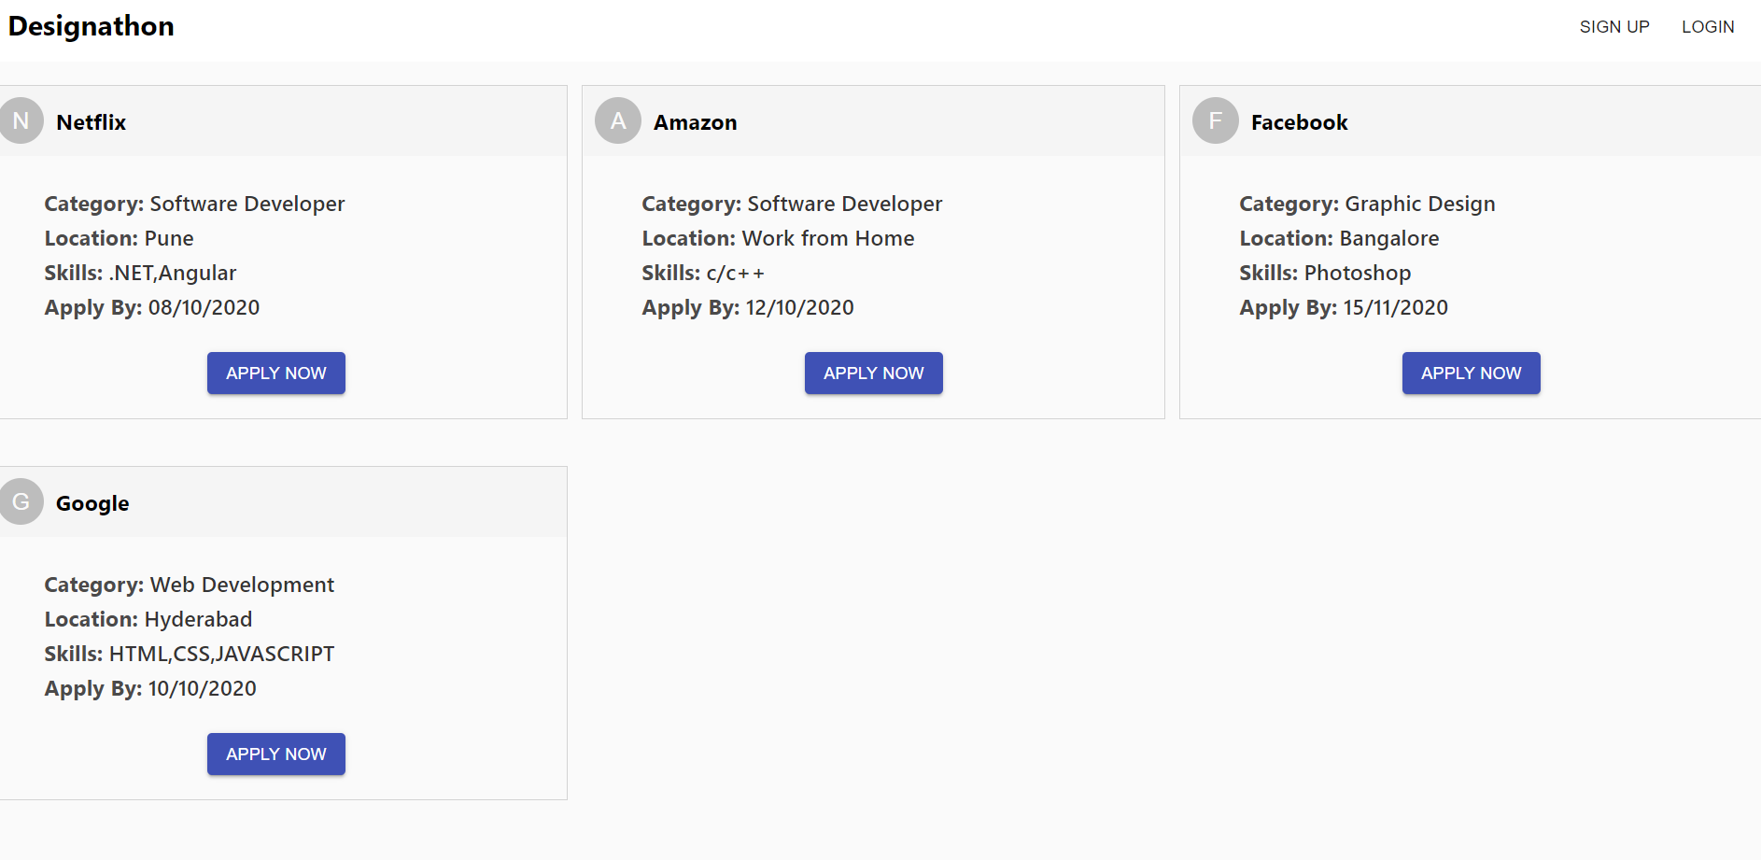
prototype
A single page web application designed by using React , in which a company can post a job and a student can apply for that job

Slide 4
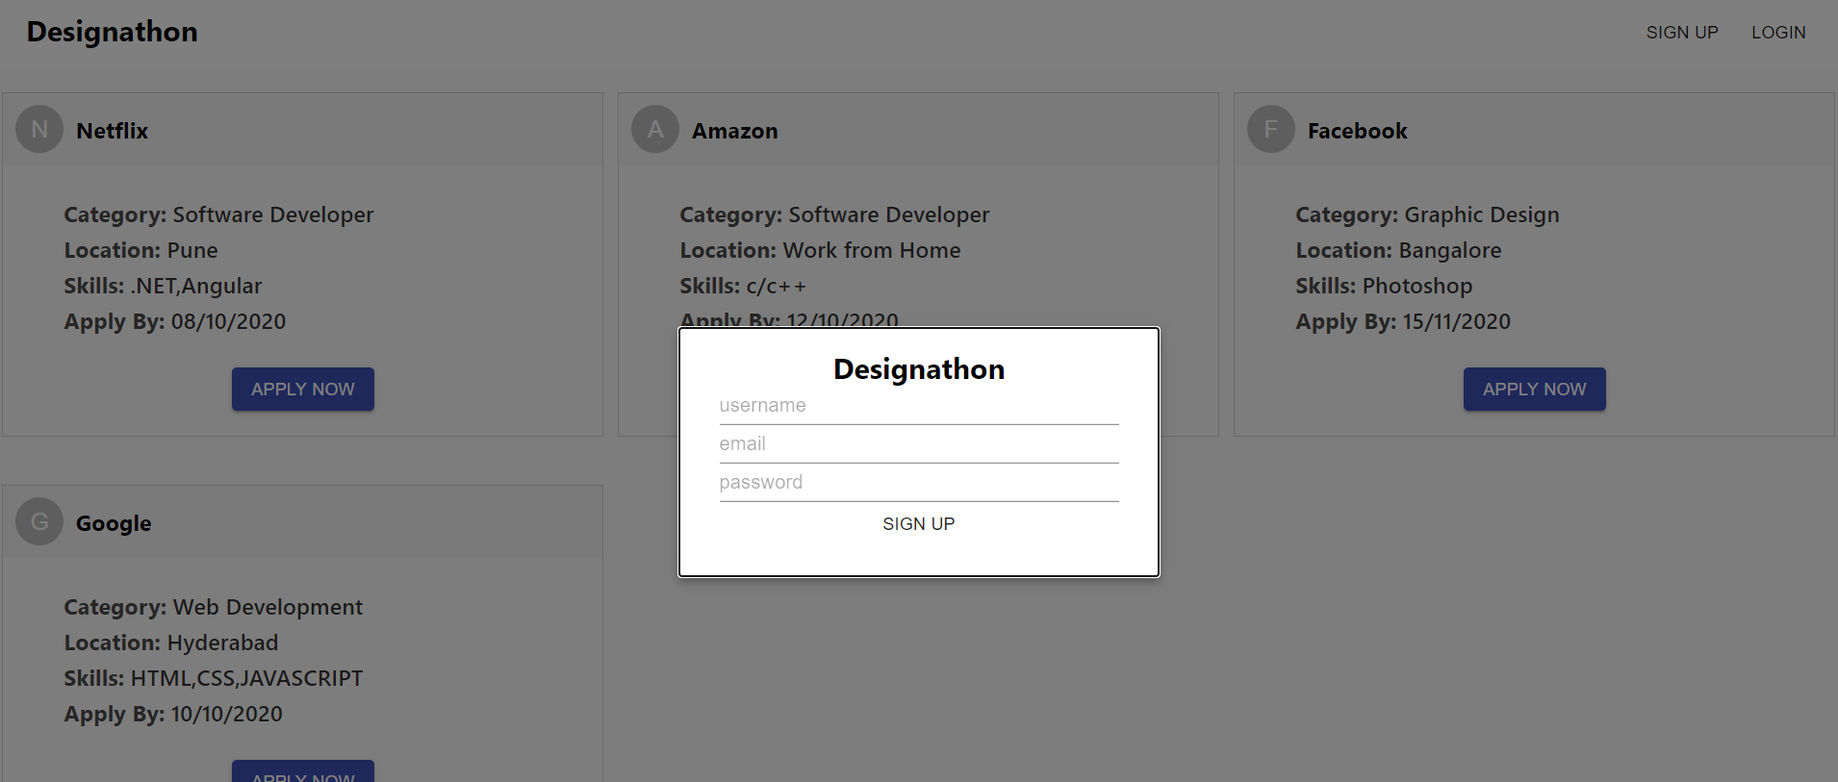
A company or a student can signup and login to the website:

Slide 5
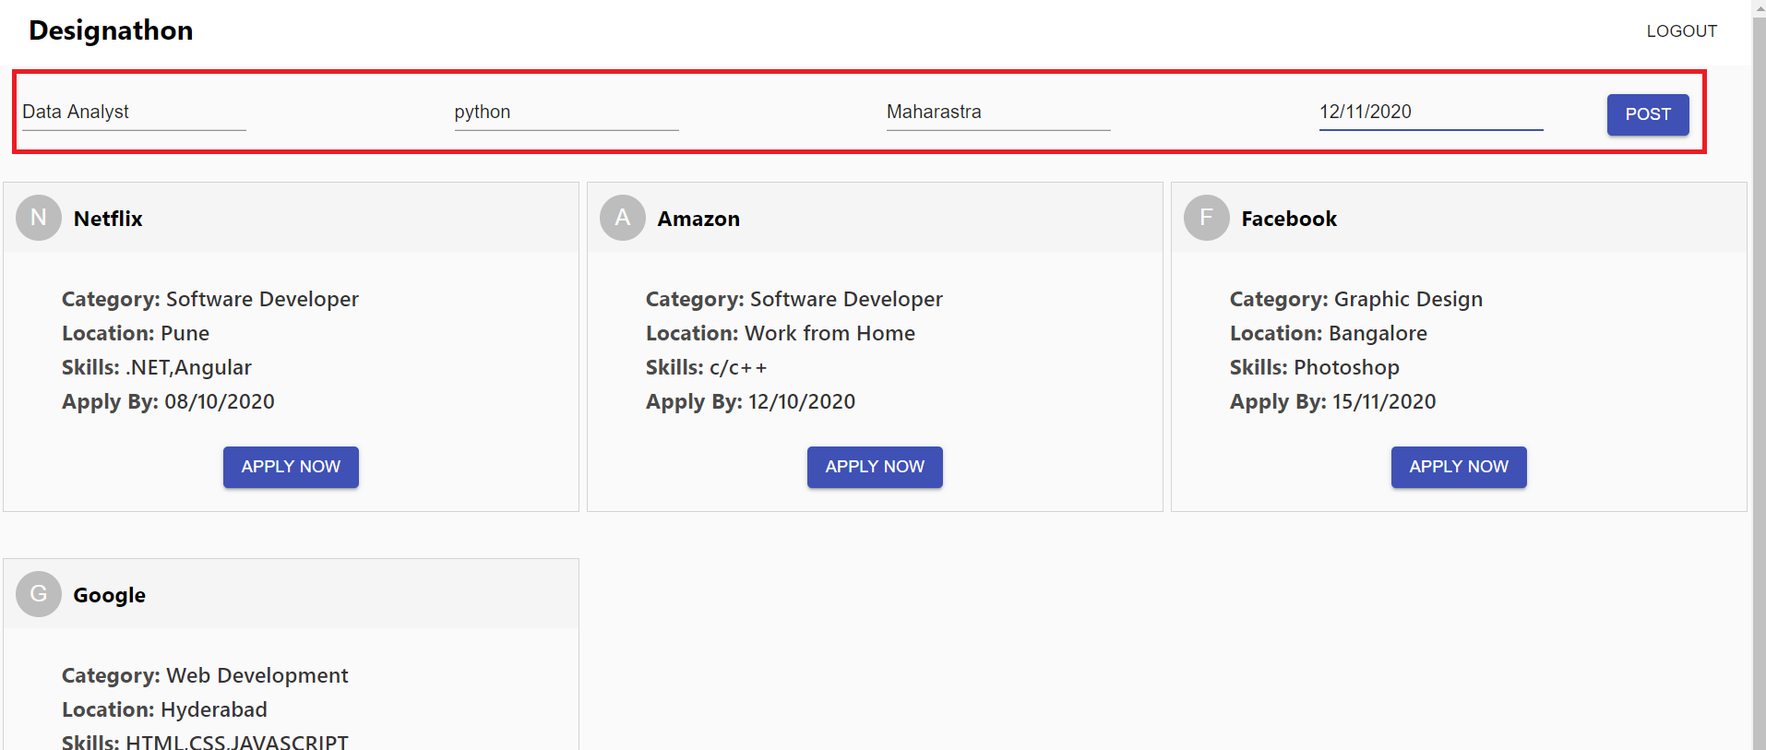
After signup, logout and login with your credentials , you get a option to post a job , fill the details and click on post:

Slide 6
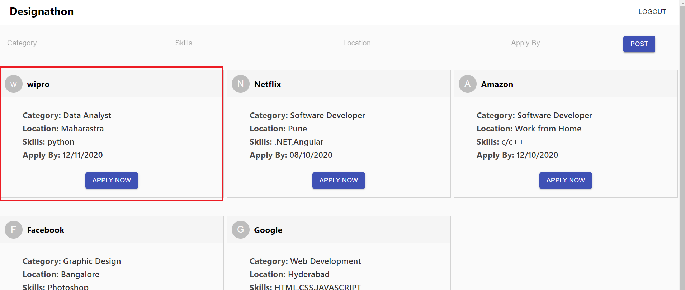
The job gets posted:

Slide 7
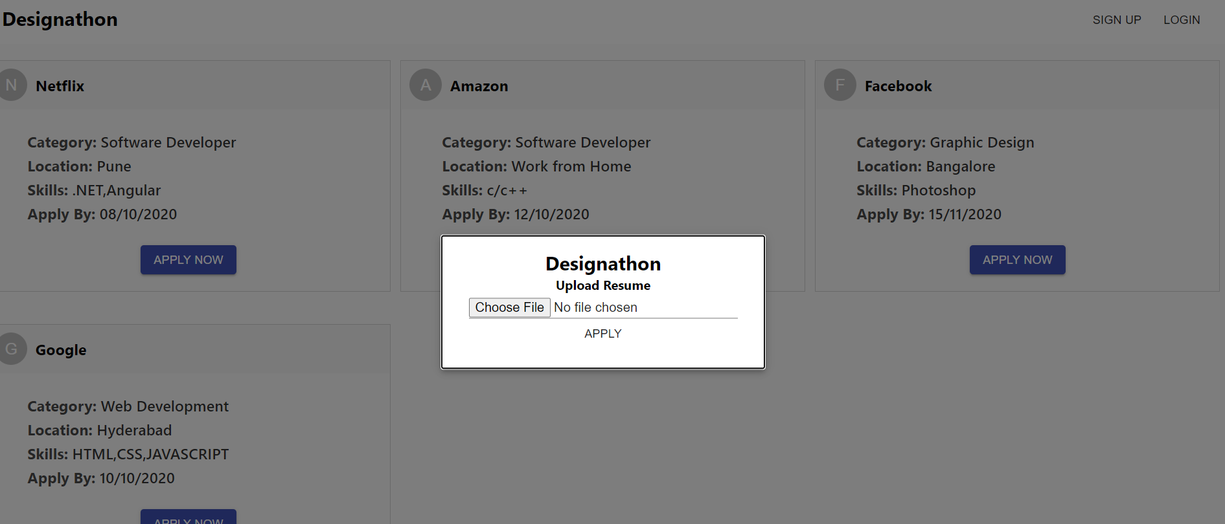
On clicking apply now button , student can upload their resume and apply for the job:

